Slide 1
Lecture 7
Network Models of Cities
7.2 Fractals and Fractal Dimension, Mobility and Interactions
IUS 3.2.2: Part 2, pp 77-82
©Luís M. A. Bettencourt 2024
Notes:
This module introduces a more formal way to compute human interactions over space, and the concept of fractal dimensions of a trajectory.

Slide 2
Four Principles of Urban Organization
1) Cities are mixing populations (networks) over built space and time
2) Personal effort is limited
3) City infrastructure as decentralized but hierarchical networks
4) Socioeconomic products of cities are the result of interactions,
subject to spatial costs
Jacobs, Wirth, Burgess
Park, Milgram, Zahavi, Simon
Alexander
Jacobs
Alonso
already in the amorphous model, but more to come…

Slide 3

To get closer to the right answer need:
To understand fundamental constraints on human interactions
To understand the general characteristics of urban spaces
A better model of social interactions over built space
To better compute costs of transportation and land rents

Slide 4
Socioeconomic interactions are proportional to local social interactions
Net benefits (interactions):
sum over all agents in population
$$y_{i}^{m}=g_{m}k_{i}^{m}$$
$$Y^{m}=g_{m}\underset{i}{∑}k_{i}^{m}$$
number of interactions of type m (degree)
agent i’s “income” from interactions of type m
Total income of type m in population
value per interaction
$$Y=\underset{i,m}{∑}g_{m}k_{i}^{m}$$
We want to write these quantities in terms of lifepaths
Total income of all type (like GDP)
lifepaths —> interactions networks —> degree
1. Interactions between agents i, j of type m
$$Y=\underset{i,j;m}{∑}g_{m}F_{ij}^{m}$$
recall that
$$k_{i}=\underset{j}{∑}F_{ij}$$
network of interactions of type m (over some time)
IUS pp 80-81
Notes:
We now compute how social outputs (crime, value of economic transactions, etc) can be calculated. The point is that a social network is not a physical quantity, we need to relate interactions to encounters. This page is just about the various quantities involved.

Slide 5
IUS pp 80-81
Interactions of type m for individual i:
happen when lifepaths overlap in space and time
$$F_{ij}^{m}=P(m|i,j)F_{ij}≃P(m)F_{ij}$$
probability of type m interaction,
given agents are i,j
mean field approximation
(probability of interaction type is
independent of specific pair)
$$k_{i}^{m}=∫dt\underset{j}{∑}P(m|i,j)Γ^{m}(x_{j}[t]-x_{i}[t])≃\frac{P(m)}{A_{n}}∫dtd^{D}xΓ(x-x_{i}[t])$$
$$a_{0}$$
$$=P(m)a_{0}ℓ\frac{N-1}{A_{n}}$$
$$ℓ$$
counts coincidences in spacetime
life path:
$$x_{i}[t]$$
IUS Fig. 3.9
assume volume of world line is the same
length+ width regardless of city: conserved human effort
$$y≃\overline{g}\frac{a_{0}ℓ}{A_{n}}N=G\frac{N}{A_{n}}$$
on average:
$$\overline{g}=\underset{m}{∑}P(m)g_{m},G=a_{0}ℓ\overline{g}$$
This is an average result (over time and city population):
different people have different lifepaths varying over time, expressing their preferences, constraints, growth, etc
keeps track of time
Notes:
This shows how we can specify interactions of different types, as physical encounters. Note that this is an exact expression to begin with, but that to obtain the result of N/A that gives us scaling relations, we must take an average over the population in the available area of the city (the networked area).

Slide 6
To get closer to the right answer need:
To understand fundamental constraints on human interactions
To understand the general characteristics of urban spaces
A better model of social interactions over built space
To better compute costs of transportation and land rents

Slide 7
How do people move and interact in a city?
city
city
city
…
lines
point
area
(intentional behavior along a path)
(stay at home)
(roam anywhere)
These behaviors entail different (fractal) dimension of movement in the city…
IUS Figure 3.8
The life path has a different spatial dimension
Notes:
Finally, we want to discuss the fact that the life path can have different physical dimensions, called fractal dimensions. If people only visit one (or few places) it behaves more like a point, if they visit a few places along a trajectory it is a line (as we have been assuming), and it it covers all the area of the city it becomes like an area.

Slide 8
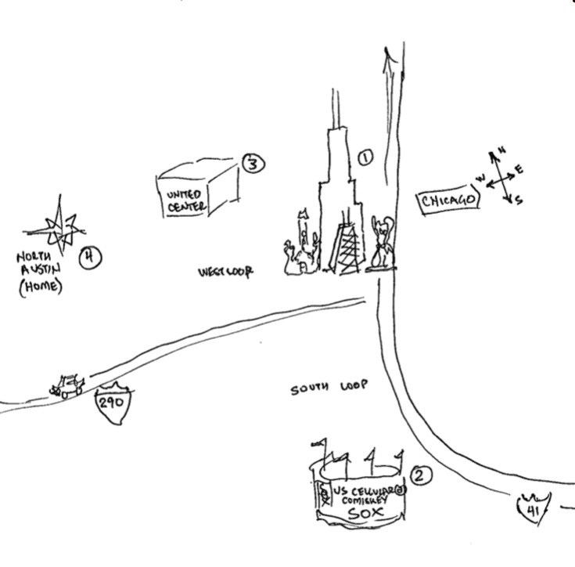
Cognitive Maps of Cities (legibility)
Kevin Lynch: Image of the City
Cities are not visited as a whole, but particular places of interest

Slide 9
Concept (a detour):
Fractal Dimensions and Fractal Geometries
Notes:
A brief introduction to ideas of fractals and fractal dimensions.

Slide 10
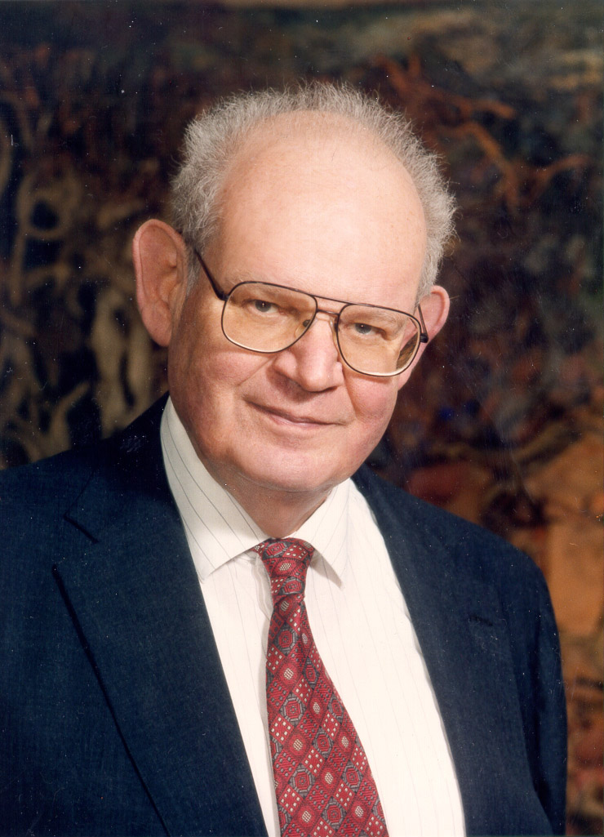
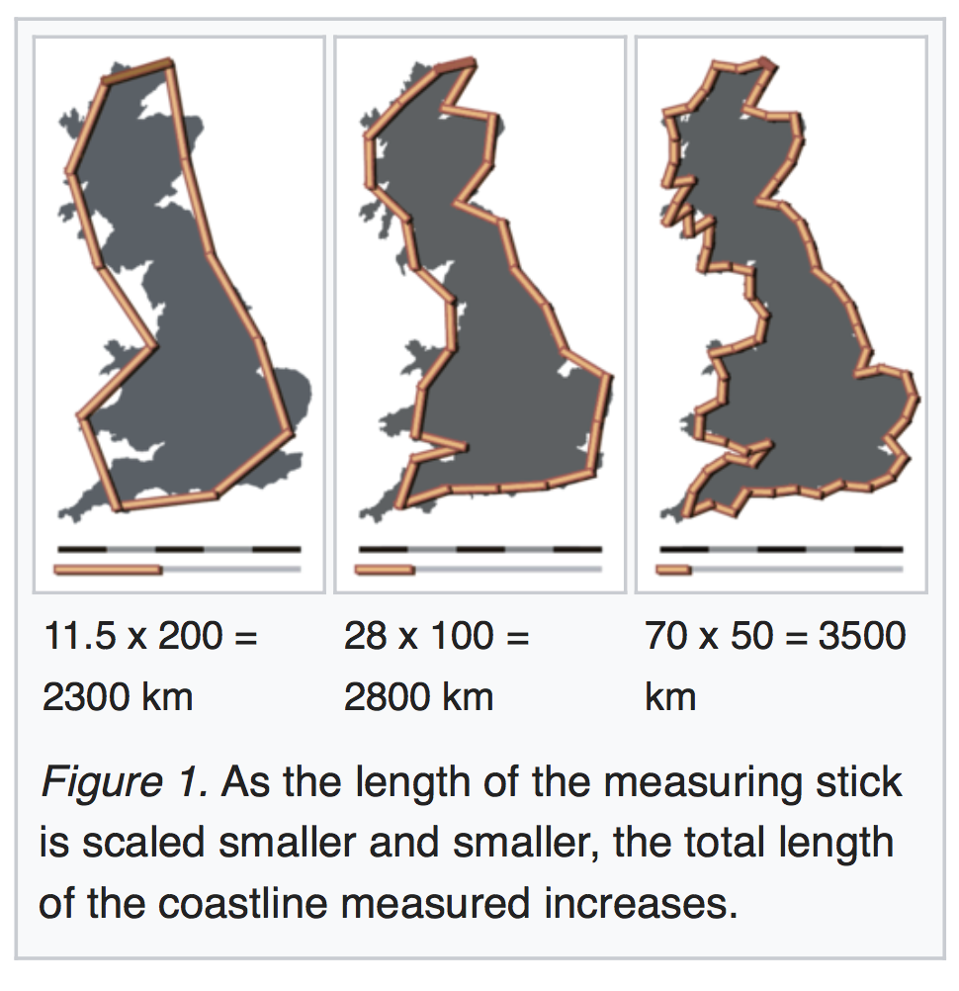
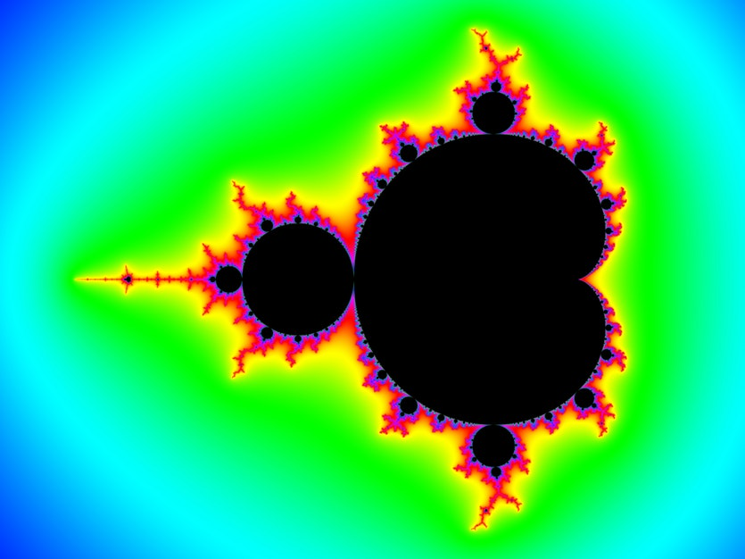
fractals and “weird” (spatial) dimensions
Benoit Mandelbrot
Mandelbrot set
credit: wikipedia
Scale invariance (1985)
solutions (in complex plane) of $c:f_{c}(z)=z^{2}+c$ remains bounded
https://en.wikipedia.org/wiki/Mandelbrot_set

Slide 11
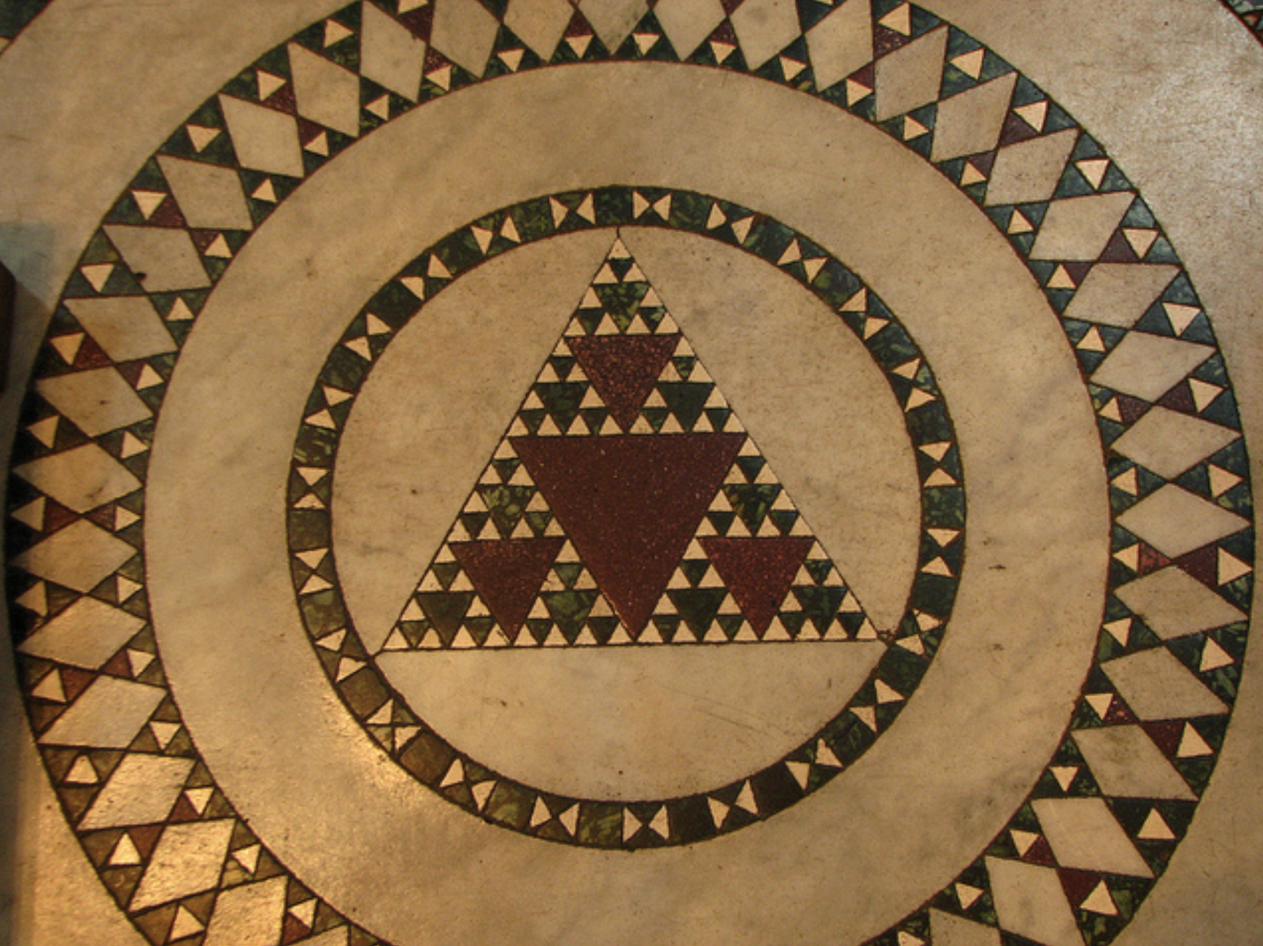

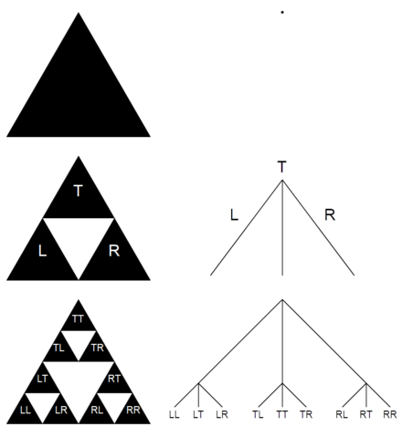
Sierpinski Triangle
Hausdorff dimension of log(3)/log(2)≈1.58
We will use this idea to fill urban land
with buildings
and
a hierarchy of infrastructure networks
https://en.wikipedia.org/wiki/Sierpiński_triangle
Floor : Santa Maria Trastevere, Rome

Slide 12
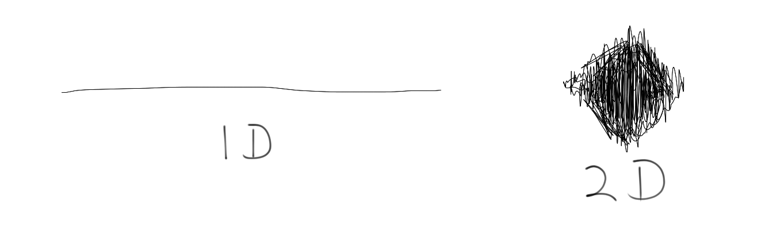
Let’s use these ideas first in the amorphous settlement model:
lifepaths (urban mobility) can have different (fractal) dimensions
depending on the space they take up
$H_{m}$=0
$H_{m}$=1
$H_{m}$=2
We will take our world line to possibly have different fractal dimensions
$$ℓ=A^{{H_{m}}/2}$$
IUS pp 77
Notes:
Back to the dimensions that a trajectory can take: this leads to a potential correction to scaling, We write the length of the trajectory (over some time) as a function of Hm, the fractal dimension of mobility.

Slide 13
The Amorphous Settlement Model
maximal spatial limit to the city
per individual:
net benefits~expected number of interactions = costs of movement
$$y=G\frac{N}{A}$$
$$C=c_{T_{0}}R^{H_{m}}$$
lower bound on income
fractal dimension of movement
$$A(N)={\left(\frac{\sqrt{π}G}{c_{T_{0}}}\right)}^{\frac{2}{2+H_{m}}}N^{\frac{2}{2+H_{m}}}$$
Area:
sublinear
D is the dimension of space, usually D=2
exponent:
$$α=\frac{D}{D+H_{m}}$$
$H_{m}$ is the fractal dimension of mobility, usually $H_{m}=1$
Expresses how these two spaces fit together
Notes:
Bringing this back to our calculations, allows us to express scaling exponents in terms of the dimensions of space (we usually work in 2-dimensions, D=2), and the dimensions of their life path. Note that scaling exponents are essentially how these two geometries fit into each other.

